Slide 1
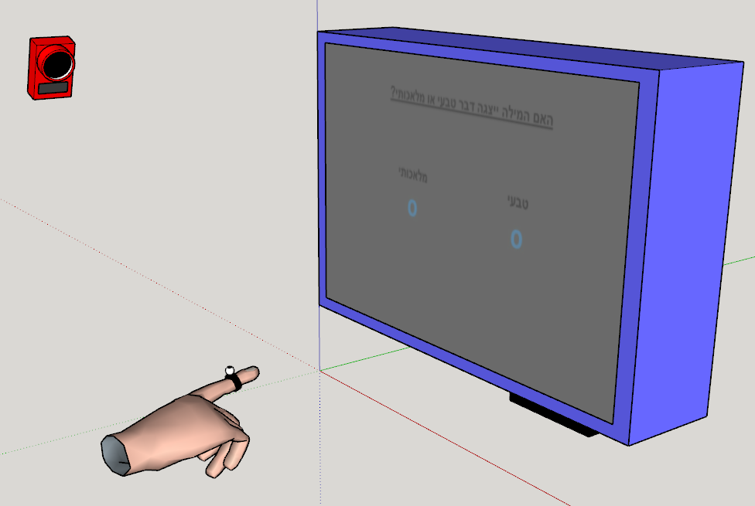
Screen
Z index
Z index
same
diff
X pos
X pos

